Slide 1
Milestone 4: Presenting Your Findings
Report Olympic Sport Stats

Slide 2
Contents
Questions/Hypotheses/Approach;
Technical Challenges;
Presenting Entity Relationship Diagram (ERD);
Findings/Deeper Analysis;
Hypotheses Results.

Slide 3
Section 1: Questions to Answer
Q1: How relevant are the physiognomy characteristics of winner athletes?
Q2: Which geographic locations gathered more medals?
Q3: What is the relationship between sport and country?
Q4: Can we assume that women and men reached equality of participants over the last years?

Slide 4
Section 2 Initial Hypotheses
Hypotheses 01: Younger participants win more medals;
Hypotheses 02: Northern countries win more medals;
Hypotheses 03: Developed countries win more medals;
Hypotheses 04: The ratio of male to female participants decreased.

Slide 5
Section 3: Data Analysis Approach
A1: Multiple queries gathering basic statistics.
A2: Calculating averages, std. Deviations, min and max over the physic characteristics;
A3: The construction of multiple graphics.

Slide 6
Technical Challenges
More data is needed to draw deeper conclusions. Developed countries win more medals, but why?;
Queries with multiple conditions tend to take a long time to produce results;
Free SQL platforms are very limited.

Slide 7
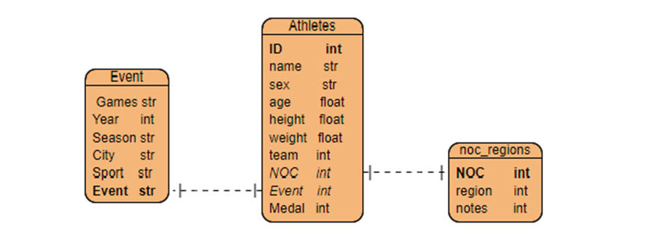
Entity Relationship Diagram (ERD)

Slide 8
Initial Findings
Based on the Avg., Std., Min and Max, it was possible to trace the first physical physiognomy for frequent medal winners;
There doesn't seem to be a correlation between northern countries winning more winter events and southern countries winning summer events;
Developed countries win more medals than others;
The ratio of male to female participants has decreased, but the gap has widened in recent years.

Slide 9
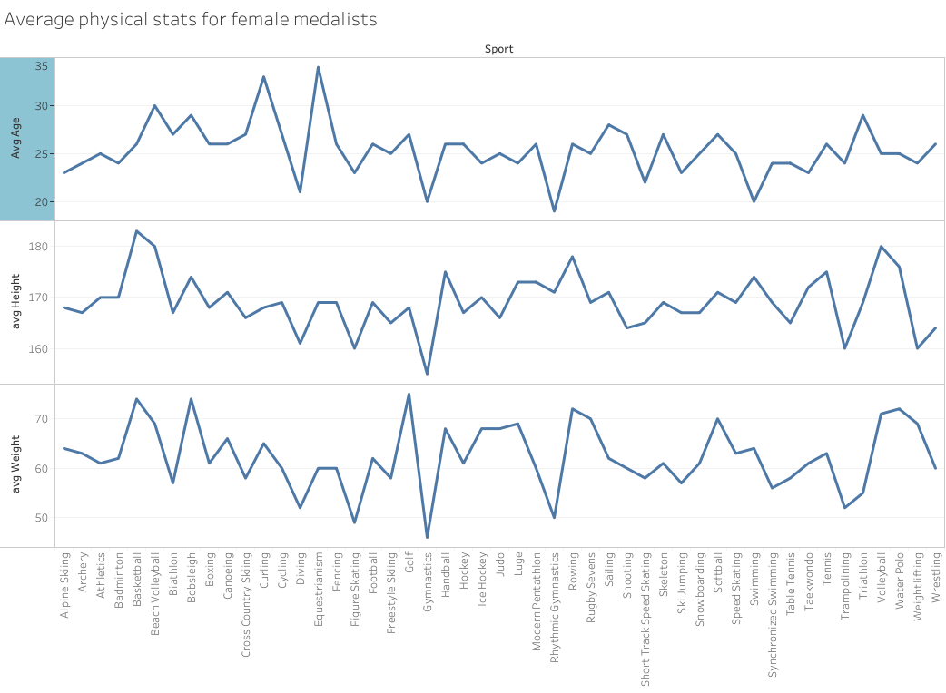
Initial Findings

Slide 10
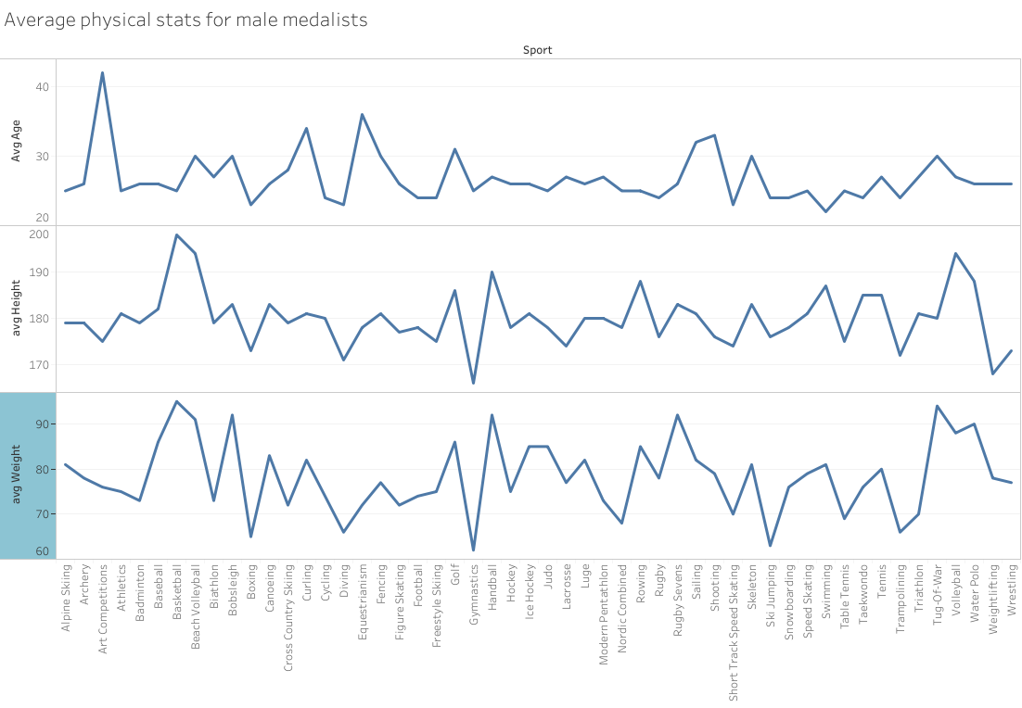
Initial Findings

Slide 11
Deeper Analysis
Example 1: A female alpine skier, 24 years old, 168 cm's and 64Kg is the average profile for an athlete in this sport, increasing the chances of winning a medal.
Example 2: A female wrestler, 26 years old, 165 cm's and 60Kg is the average profile for an athlete in this sport, increasing the chance of winning a medal.
These insights create a potential standard for lookouts and coaches when searching for potential athletes across multiple sports.

Slide 12
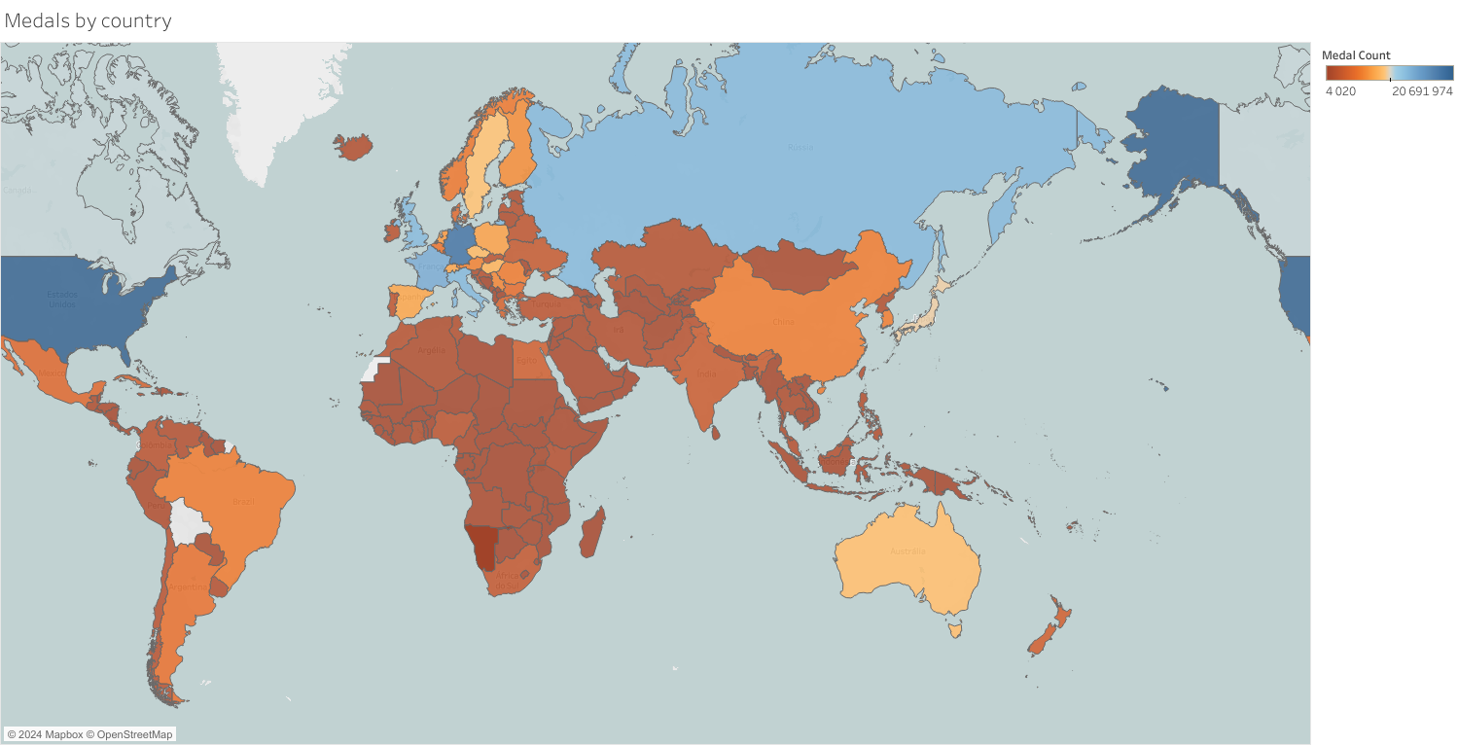
Initial Findings

Slide 13
Deeper Analysis
Northern countries (which are much more developed) are likely to win more medals than southern countries;
However, there are several reasons for these findings, more data is needed to make an even deeper analysis of these data, such as:
Year of entry;
Money invested;
Geopolitical situations.

Slide 14
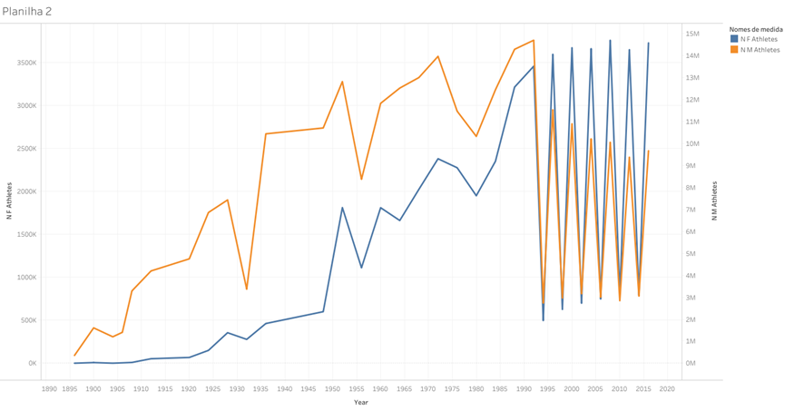
Initial Findings
The female population has raised, starting in 1960;
In 1995 the female participation has started to decrease

Slide 15
Final Findings (Result of Hypotheses)
Hypotheses 01: NO - traced a profile it depends on sport, there are several sports where older participants whin more medals;
Hypotheses 02: YES - Northern countries win more medals;
Hypotheses 03: YES - Developed countries win more medals;
Hypotheses 04: YES - The ratio of male to female participants decreased.

Slide 16
Recommendations
The Olympic Organizing Committee should help underdeveloped countries invest more in their athletes and make diversity a brand of the events;
The Olympiad Organizing Committee should promote equality between male and female and keep encouraging more female to join the Olympics.

